Slide 1
Feature Engineering
ADITYA PRABHAKARON

Slide 2
Agenda
What is a feature?
What is Feature Engineering?
Why is Feature Engineering important?
Data Preparation – Identifying & Handling Missing Values
Data Preparation – Identifying & Handling Outliers
Feature Scaling
Power Transform
Binning
Correlation Analysis
Feature Encoding
Feature Engineering – Grouping and Splitting
Feature Engineering – Extraction & Creation
Feature Selection
Data Split for Model Validation
Data Imbalance
Data Leakage

Slide 3

What is a Feature?
An attribute of a given variable which is useful for your modeling task is known as feature.
Features referred in the context of machine learning and independent variables in the context of statistics.
For example
An image is an observation, but a feature could be a line in the image
A DOB column is a variable, Day of birth is a feature
Temperature is information, Hot, Mild, Cold is features of temperature
Notes:
Feature helps you make sense of raw data – it is processed data in a form which helps generate meaningful insights about the process/domain and achieve a particular objective – say classification, regression etc.

Slide 4
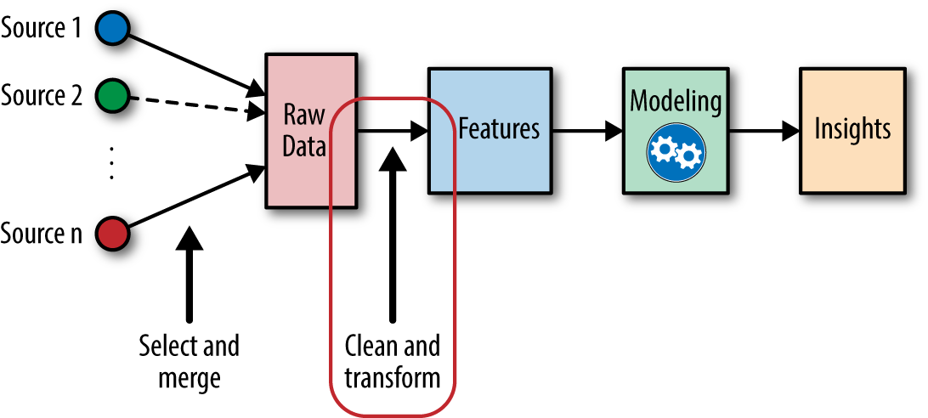
What is Feature Engineering ?
The process of extracting / creating new features from the existing data by using domain knowledge and experimentation and improve the performance of the data modelling is known as feature engineering.
It often involves data transformation, data combining and data exploration.
Feature Engineering is a Representation Problem and a Creative Task (like Art)
Be Agile – Do not be stuck in one stage of the pipeline – often insights about the features and their effectiveness can be inferred by analyzing the results of a model trained using them.
Notes:
Feature engineering are a set of broad techniques which generate the best combination of features to achieve to gain insights and maximize performance (accuracy etc.)
There are no fixed rules but only rule of thumbs
Involves some amount of trial and error. It is a creative process.

Slide 5
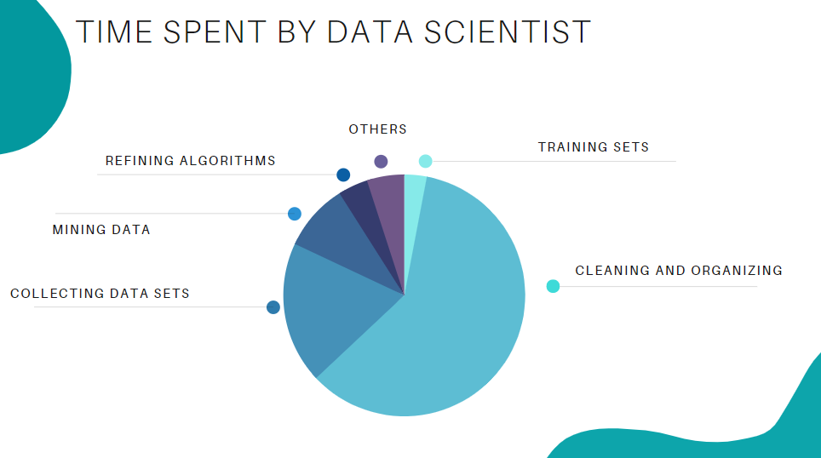
Why is Feature Engineering important?
Current format of variables is not suitable for model fitting requirements (encoding or scaling)
Existing variables may not directly helpful pr useful for the model
Interaction effects are key players in decision making
Advantages of Feature Engineering:
Better results and insights
Less complex models
Explainability
Disadvantages of Feature Engineering:
Takes time
Often involves trial and error
Require domain knowledge
“ At the end of the day, some machine learning projects succeed, and some fail. What makes the difference? Easily the most important factor is the features used. ” — Prof. Pedro Domingos from the University of Washington
Notes:
A lot of time in a DS project is consumed for data preparation and feature engineering – so it is very critical – can make or break the project

Slide 6
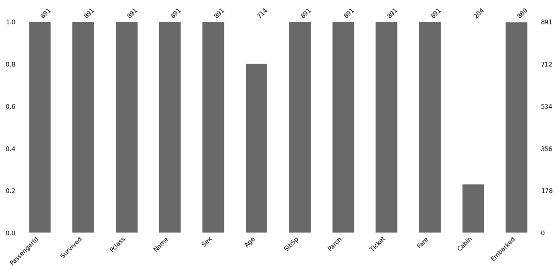
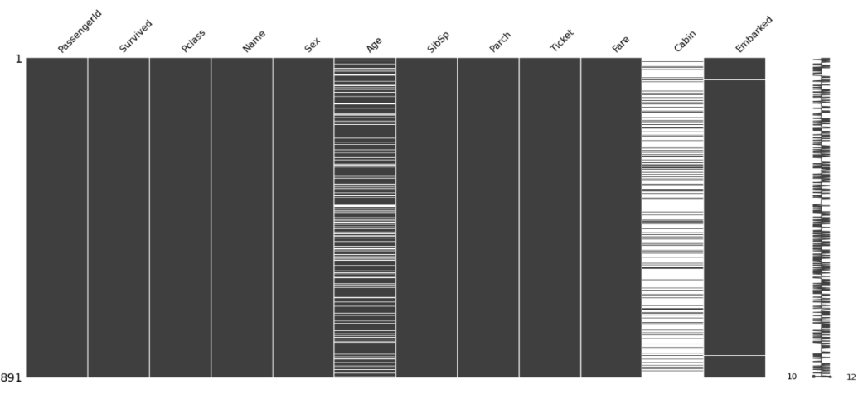
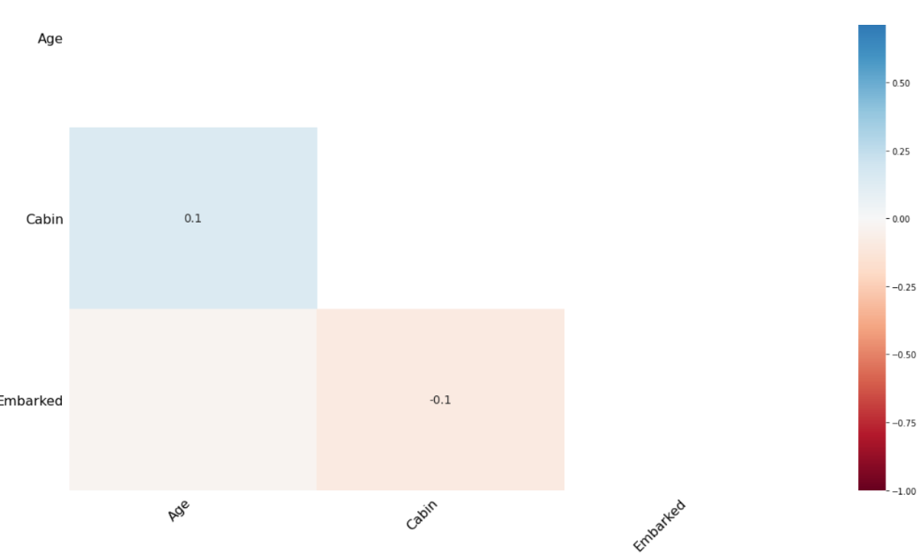
Data Preparation – Identifying & Handling Missing Values
Why are data points found missing?
Missing Completely At Random (MCAR)
Missing At Random (MAR)
Missing Not At Random (MNAR)
Data Visualization & Exploration to understand missing data:
How many missing values per column/feature?
Are the missing values spread evenly or consecutive or periodic?
Is there a correlation between missing values of different columns?
The method of handling missing values depends on why it is missing, how much is missing and pattern of missing values
Notes:
Missing completely at random (MCAR):
Suppose variable Y has some missing values. We will say that these values are MCAR if the probability of missing data on Y is unrelated to the value of Y itself or to the values of any other variable in the data set. On another hand, missing value (y) neither depends on x nor y.
EXAMPLE - suppose in a library there are some overdue books. Some values of overdue books in the computer system are missing. The reason might be a human error like the librarian forgot to type in the values. So, the missing values of overdue books are not related to any other variable/data in the system.
Missing at random (MAR):
The probability of missing data on Y is unrelated to the value of Y after controlling for other variables in the analysis (say X). on another hand, Missing value (y) depends on x, but not y.
EXAMPLE - Survey data, the people have answered their ‘Gender’ but ‘Age’ values are mostly missing for people who have answered their ‘Gender’ as ‘female’. (The reason being most of the females don’t want to reveal their age.)
In this case, the variables ‘Gender’ and ‘Age’ are related and the reason for missing values of the ‘Age’ variable can be explained by the ‘Gender’ variable but you can not predict the missing value itself.
Not missing at random (NMAR):
Missing values do depend on unobserved values. On another hand, the probability of a missing value depends on the variable that is missing.
EXAMPLE - the purpose of the survey is to measure the overuse/addiction to social media. If people who excessively use social media, do not fill the survey intentionally, then we have a case of NMAR. Another example, people having very less or very high income may refuse to share that information in a survey. This will most probably lead to a bias in results.
In the matrix plot, you will see blank lines for each missing data. Notice that the ‘Embarked’ column has just two random missing data, which follow no pattern. They were probably lost during data acquisition. So, this can be classified as Missing completely at Random.
The age and Cabin columns could possibly be MAR. But we want to ensure that there are no correlations between them.

Slide 7
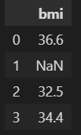
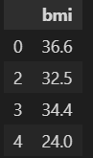
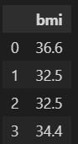
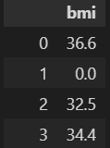
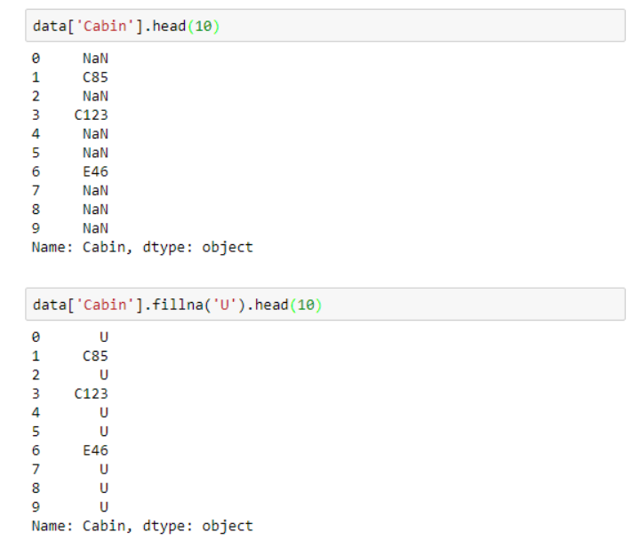
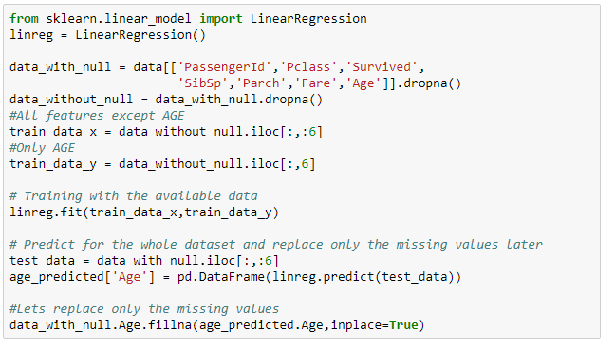
Data Preparation – Identifying & Handling Missing Values
Example
1. df.dropna()
2. df.fillna (method= bfill)
3. df.fillna (value=0)
Handling Missing Values:
Delete row/column – if most features are NaN for a row or most data points are NaN for a feature – only if missing data is less and feature is not important.
Imputing with mean/median/ – disregards/weakens the relationship/correlation of given feature with other features – For data with outliers, prefer median imputation over mean.
Interpolation – backward fill, forward fill, linear interpolation, seasonal mean – Sequential (Time Series) data
Prediction missing values using a Model – Increases correlation and bias in the data
For Categorical Variables:
Mode (most frequent category)
Separate category for missing values
Separate Category for missing values
Predicting missing values using a model
The method of handling missing values depends on why it is missing, how much is missing and pattern of missing values
Notes:
When outliers are present in data, imputing with median is preferable over mean.
Mean/Median/mode Imputation – This method disregards the relationship/correlation of the given variable with other variables in the data set since it only uses the statistics of the variable (central tendency measures) for imputation. So in this case, this method will further weaken the correlations amongst variables.
Regression/Prediction – This uses the relationship or correlation of the given variable (with missing values) with other variables and exploits this through the model to predict the missing value based on the other variables. This increases the correlation amongst the variables but assumes that these correlations fully capture the missing values. So this method is in principle opposite to that of method 2 (statistical measure based imputation).
Separate category for Missing: Assumes that all missing values are similar but are different from the existing categories (by assigning them all to a single “missing” category)

Slide 8
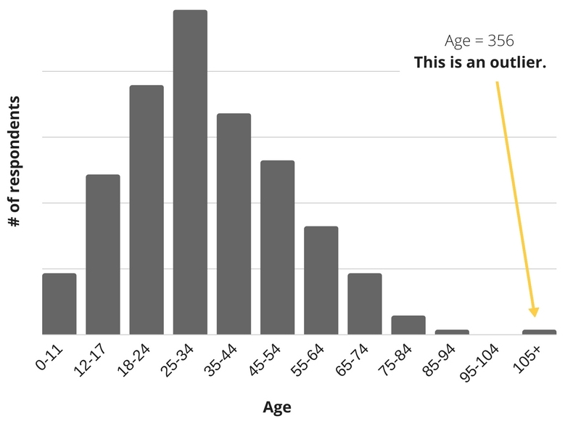
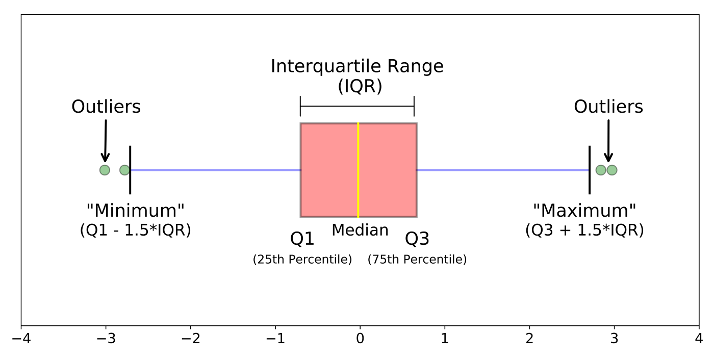
Data Preparation – Identifying & Handling Outliers
Outliers can be identified when plotting the data distribution or using a boxplot where the outliers lie outside the “whiskers”.
Handling Outliers:
Removal: Outlier-containing entries are deleted from the distribution provided there aren’t too many outliers.
Replacing values: Alternatively, the outliers could be handled as missing values and replaced with suitable imputation (median or prediction).
Capping/Clipping: Using an arbitrary value or a value from a variable distribution to replace the maximum and minimum values.
Discretization: Discretization is the process of converting continuous variables, models, and functions into discrete ones. This is accomplished by constructing a series of continuous intervals (or bins) that span the range of our desired variable/model/function.
Identifying outliers and treating them requires domain knowledge apart from statistical methods.
Notes:
Domain knowledge or understanding plays an important role in determining data points as outliers – For example property insurance claims - Most claims are small, but occasionally there is that one enormous claim.
the enormous claim is one that is unlikely to reoccur for any number of reasons. Hopefully there will never be another September 11 type destruction of two World Trade Center buildings owned by a single owner (and similarly health insurance during Covid).
Another example is when the insurance policy terms are revised to literally prohibit a specific kind of claim in the future.
Another possibility is that the specific claim is unlikely to reoccur (the insurance company stopped insuring wheelchairs, so there won’t be another wheelchair claim), but that claim is representative of another kind of claim that is likely to occur. In this case, the outlier should not be deleted.

Slide 9
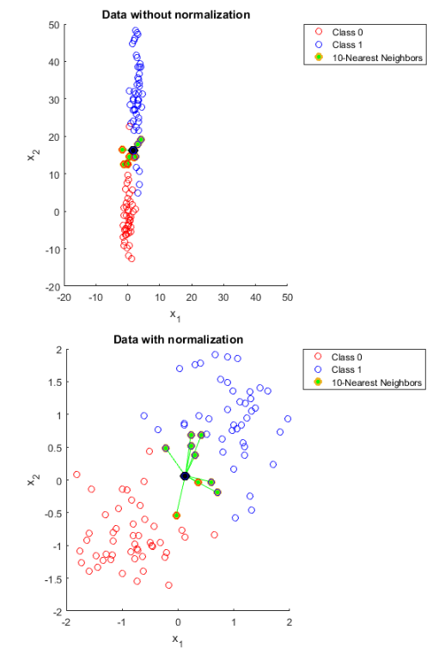
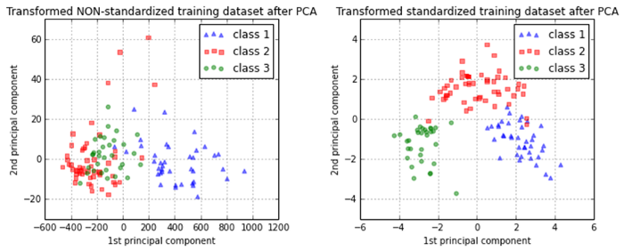
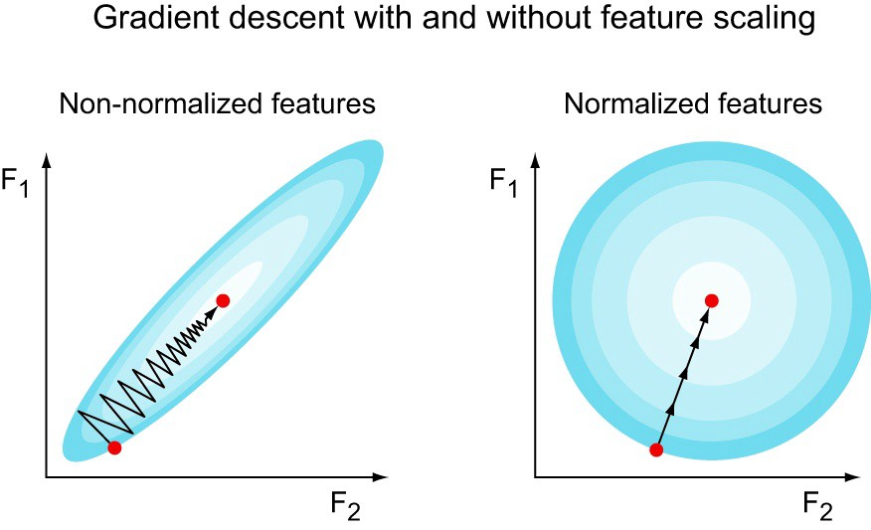
Feature Scaling
What happens in the absence of feature scaling?
Without feature scaling, models like kNN estimate skewed distances ; Principal Components of PCA fail to capture the variance in the data ; Gradient Descent bounces around and does not converge to the optima quickly
Notes:
http://www.faqs.org/faqs/ai-faq/neural-nets/part2/section-16.html
Why feature scaling:
Any algorithm which has a notion of distance embedded in it will give erroneous values without feature scaling (it will favor features with higher mean and std dev).
Some algorithms might not even converge without scaling. Helps iterative numeric methods like gradient descent converge faster AND prevents them from getting stuck in local minima;
Drawback:
Direct/easy Interpretability of values and their units (since everything is 0 to 1) - So remember to convert back to original scales before reporting and visualizing results and plots for ppl to understand
When should you use standardization vs normalization (min-max scaling)? (HINT: Previous Slide) (Which is better for outliers?) – Though Standardization is relatively better than MinMax, the Std Dev may still be affected to outliers (so using Inter-Quartile ranges like RobustScaler of scikit-learn is explicitly robust to outliers)
In summary, it can be said that standardization gives the features a comparable scaling, but without highlighting outliers. By contrast, normalization gives the features exactly the same scaling. This can be very useful for comparing the variance of different features in one plot (like the boxplot on the right) or in several plots of the same scale.
STANDARDIZATION – CLUSTERING, PCA
MINMAX SCALING – Scaling pixel intensities of raw image; NN if it requires values in [0,1]

Slide 10
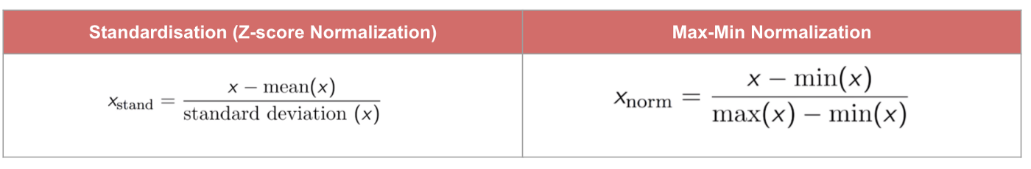
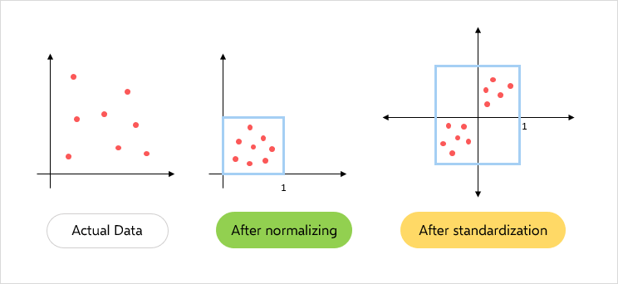
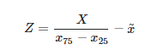
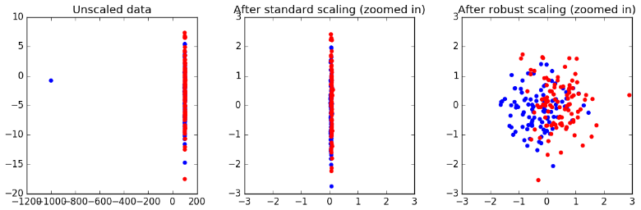
Feature Scaling
Ensures model does not focus more on features with higher mean/variation
Any model which uses a notion of distance needs feature scaling as a preprocessing step – k-means, kNN, SVM etc.
Most common methods are Standardization (Z-Score) and Min-Max Scaling
Min-max Scaling is good choice when both the following conditions are met:
You know the approximate upper and lower bounds on your data with few or no outliers.
Your data is approximately uniformly distributed across that range.
A good example is age, a bad example is income (skewed by some outliers)
Standardization is useful when there are a few outliers, but not so extreme that you need clipping.
When outliers are many, another method is Robust Scaler in scikit-learn which uses the median and interquartile range instead of mean and standard deviation of standardization and hence is more robust to outliers.
Robust Scaler
where x~ is the median and x75− x25 is the interquartile range
https://sebastianraschka.com/Articles/2014_about_feature_scaling.html ; http://www.faqs.org/faqs/ai-faq/neural-nets/part2/section-16.html
Notes:
http://www.faqs.org/faqs/ai-faq/neural-nets/part2/section-16.html
Min Max Scaling: The motivation to use this scaling include robustness to very small standard deviations of features and preserving zero entries in sparse data.
When should you use standardization vs normalization (min-max scaling)? (HINT: Previous Slide) (Which is better for outliers?) – Though Standardization is relatively better than MinMax, the Std Dev may still be affected to outliers (so using Inter-Quartile ranges like RobustScaler of scikit-learn is explicitly robust to outliers)
In summary, it can be said that standardization gives the features a comparable scaling, but without highlighting outliers. By contrast, normalization gives the features exactly the same scaling. This can be very useful for comparing the variance of different features.

Slide 11
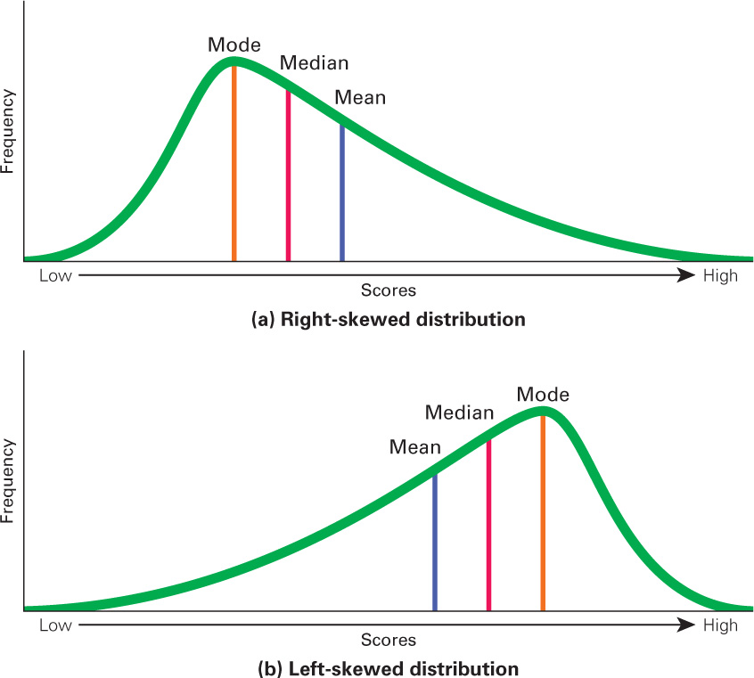
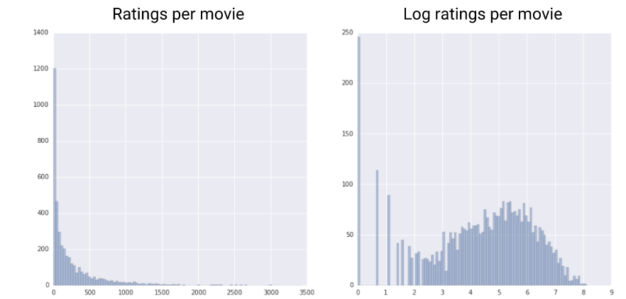
Power Transform
Commonly applied to skewed distributions
Helps address outliers and to build a linear model on non-linear data
Taking logs or square root "pulls in" more extreme values on the right (high values) relative to the median, while values at the far left (low values) tend to get stretched back, further away from the median.
Practical example of skewed distribution – Movie ratings - most movies have very few ratings (the data in the tail), while a few have lots of ratings (the data in the head).
Advantages of Log Transform:
Reduces effect of skewness/outliers
Easily interpretable - changes in a log value are relative (or percentage) changes on the original scale. So, if log base 10 is used, then an increase of 1 on the log scale corresponds to a multiplication of 10 on the original scale.
Log transform helps reduce right skew and impact of outliers and is also convenient to interpret.

Slide 12
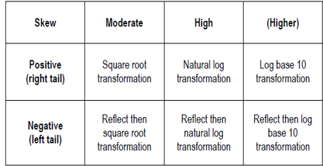
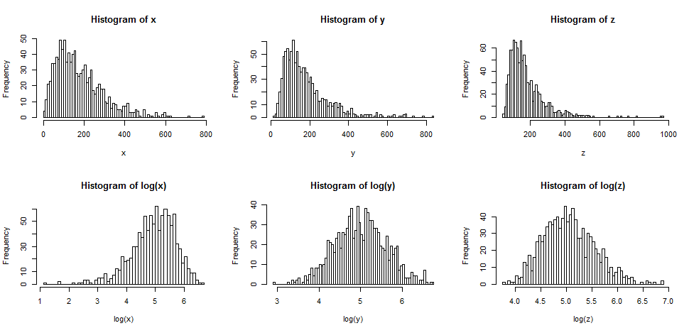
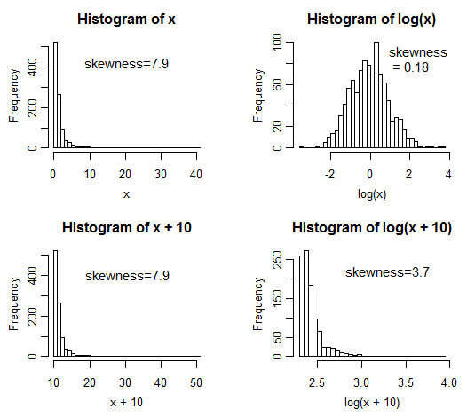
Power Transform
Such transforms are impacted by Shifting (adding by a constant) – increasing shift adds skewness to transformed data but not original.
Also, when the feature takes only discrete values and not continuous, these transforms may not change the skew - Example, if 70% of the distribution is at 1, 20% at 2 and the rest spread across higher values, then for transformed data the two lowest values would still have 70% and 20% of the values, respectively.
Features must be cleaned of zeros or negative values before applying square root or log transform
Log transform is used mainly for continuous variables which have positive, non-zero values.

Slide 13
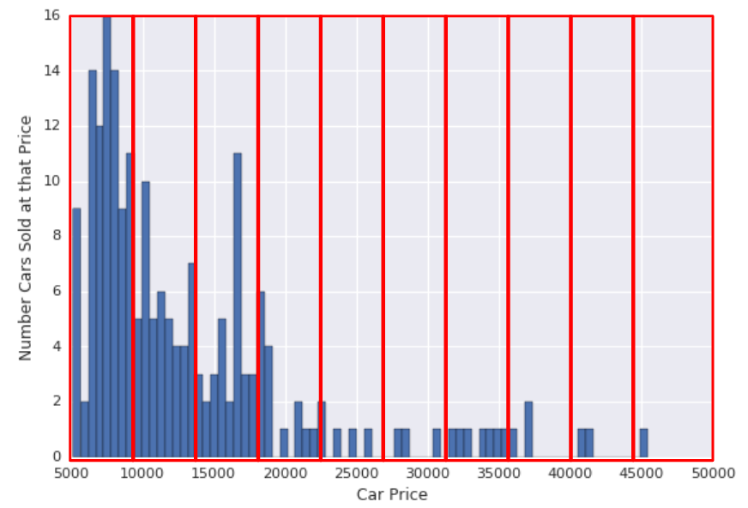
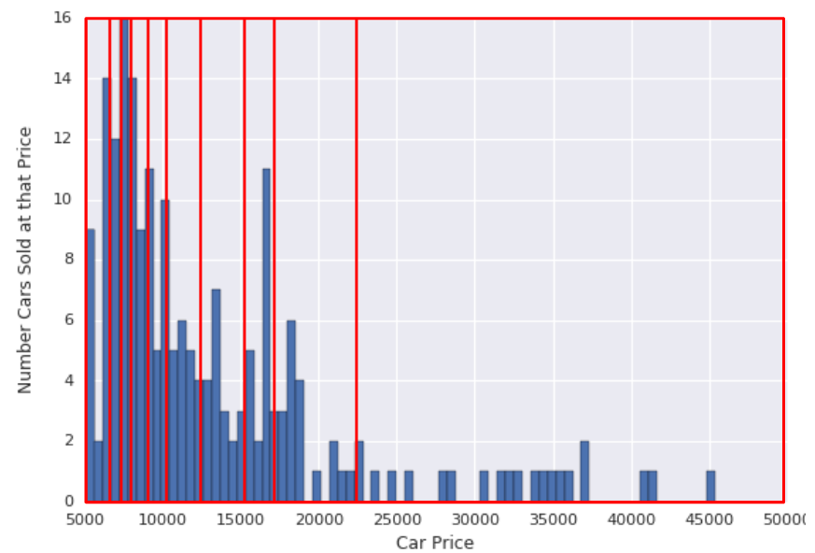
Binning
Discretization of a continuous variable into various bins/buckets.
Uniform (constant width) Binning: The boundaries are fixed and have the same range. Some bins could have many points, while others could have few or none.
Quantile Binning: Each bin has same number of points. Boundaries are not fixed and could encompass a narrow or wide span of values.
Usually, uniform binning is performed – but with skewed data, quantile binning may yield better results.
Watch Out: Binning a continuous variable can introduce error in treatment – For example, newborns are categorized into “low birth weight” and “normal” often using a cutoff of 2.5 kg. In this method, a baby of 2.49 kg is treated as being very different than one of 2.51 kg, but very like one of 1.5 kg or even 1.0 kg .But there’s no biological reason to think this happens!
Changing the bins can completely alter the model, particularly if the relationship is nonlinear.
When should you do binning?: Where nature of a variable across a boundary really is dichotomous. Example - consumption of alcohol among teens and young adults, the age where drinking becomes legal would be key.
Uniform binning
Quantile binning
Avoid binning a continuous variable unless there is a clear reason for a gap/boundary value in that variable.

Slide 14
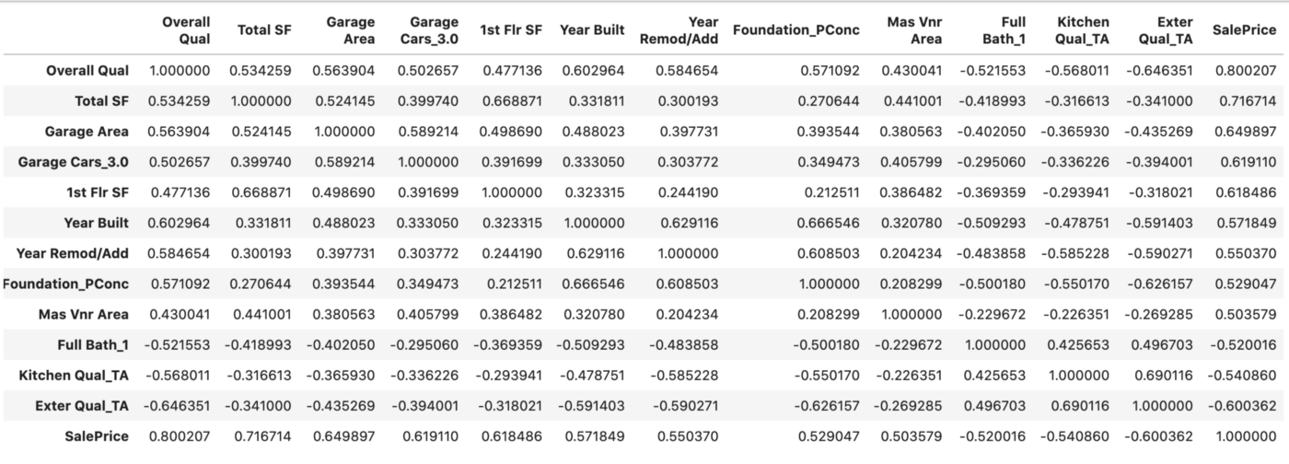
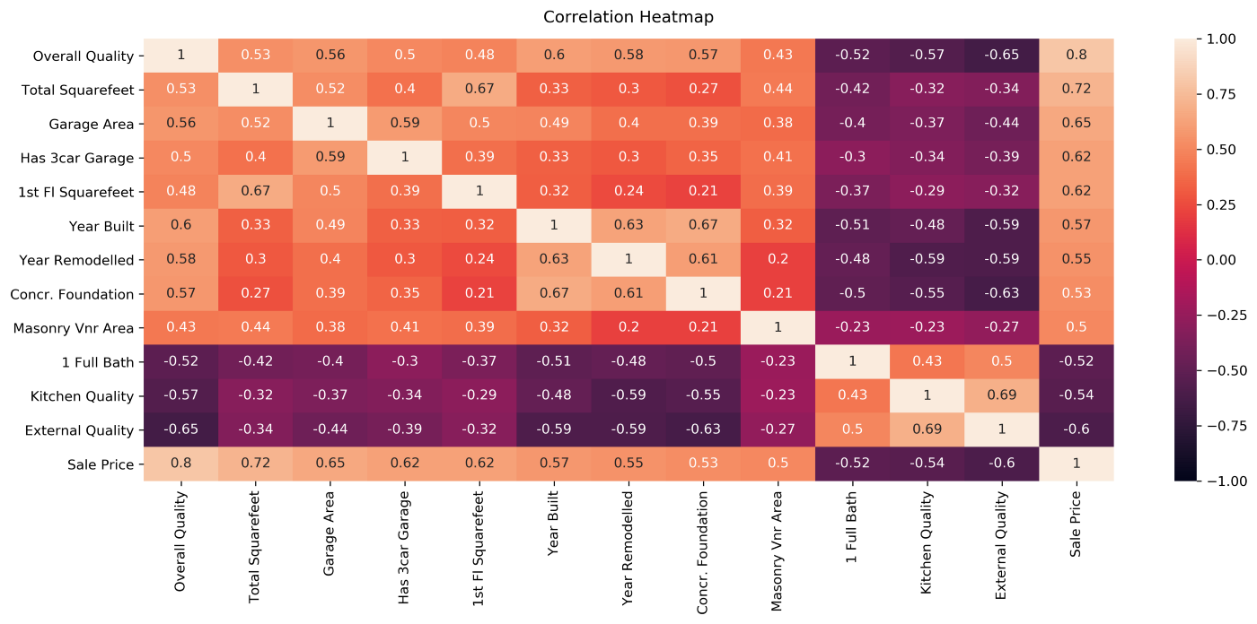
Correlation Analysis
Features highly correlated with the target variable indicate high importance but converse is not necessarily true - relationship could be non-linear as well.
Pearson’s Coefficient measures Linear Correlation while Spearman’s Rank and Kendall Tau Rank Coefficients can measure non-linear correlation.
Watch Out:
Highly correlated independent features can result in highly unstable coefficients in say a Linear or Logistic Regression model – they can swing highly based on which set of features are included in the model or if data changes slightly.
Interpretability of coefficients is lost – significance (p-values) of features does not hold in presence of strong correlated variables.
Possible solution is to remove one of the correlated variables or combine them to form a new variable and remove both the variables.
Alternatively apply dimensionality reduction technique such as PCA.
Multicollinearity can be detected using Variable Inflation Factor (VIF) and variables may be recursively removed.
Do not drop low correlation variables hastily. Check for multicollinearity and handle appropriately

Slide 15
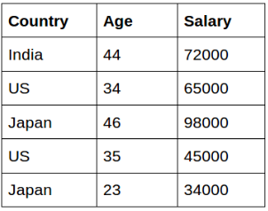
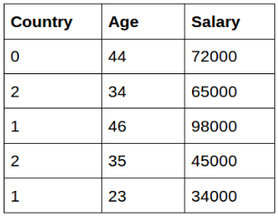
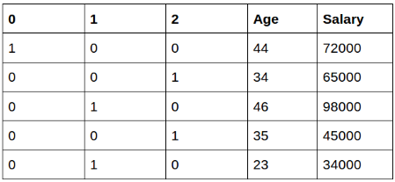
Feature Encoding
Categorical features have non-numeric (string) values which needs to be converted into numerical values for modeling
Label Encoding :
Categories of a feature transformed into single column by replacing string values with n integers where n is number of distinct categories
Implies ordinal relationship between categories so must not be used when this is not true
One Hot Encoding :
String features are transformed into ‘n’ (?) columns where ‘n’ are distinct string values of that feature
Dummy variable trap leads to multicollinearity
For high cardinality features (like pincode), this leads to very sparse representations. So other advanced techniques like Frequency Encoding, Target Encoding, Binary Encoding can be tried.
Sample dataset with string type feature
Label encoding
One hot encoding
The best type of encoding depends on the number of categories and their relationships
Notes:
Label – Implies order in relationship so generally not used for non-ordinal features
OHE – Dummy variable trap (multicollinearity) – when we encode ‘n’ category variable into ‘n’ one-hot columns, then models like Linear Regression give erroneous results – this is because the last dimension/column is not required (whenever the n-1 columns are all zero, then that implies it is the nth category automatically)
High Cardinality – Imagine 100003 categories – so each column on average is hot only for 1/10000th of the data so won’t get picked for say node splitting in a decision tree.

Slide 16
Feature Engineering – Grouping and Splitting
Input_Var | Group_Var
Tirupati | Holy_city
Goa | Beach_city
Varanasi | Holy_city
Ooty | Hill_station
Manali | Hill_station
Mount Abu | Hill_station
Kovalam | Beach_city
Pondicherry | Beach_city
Shiridi | Holy_city
Grouping - The method of combining the different categories within a variable in small groups for having better performance and understanding purpose.
Splitting - Splitting a variable in to tow or multiple features that add value individually to the modelling activity.
Input Var
Bobby (1973)
Hum Apke Hai Koun (1994)
Veer-Zaara (2004)
Umarao Jaan (1981)
Salaam Bombay(1998)
Bahubali (2015)
Chennai Express (2013)
Movie_Name | Released Year
Bobby | 1973
Hum Apke Hai Koun | 1994
Veer-Zaara | 2004
Umarao Jaan | 1981
Salaam Bombay | 1998
Bahubali | 2015
Chennai Express | 2013
The resulting features must be more meaningful and help predict the target variable than the original features
Notes:
Grouping lends meaning/context to different categories – So, if we are to look at say foot-fall for a particular shop/hotel in all of these places, we know that holy_city will see high footfall / sales only during festivals, beach_city during winter (and also some holidays like New Years) and hill_station during summers (and holidays during summers).
Similarly for splitting.

Slide 17
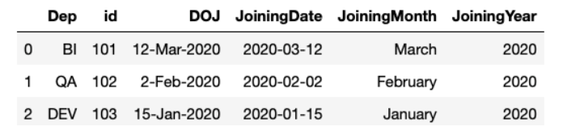
Feature Engineering – Extraction & Creation
Extraction – Extracting the feature from the existing data where the extracted feature is more useful than the original data.
Example – Extracting day of the week, month, year etc. from the timestamp column which can help identify seasonality in time series data.
Creation – Creation of new feature altogether from the given data by combining two or more variables in the data.
Example – New Feature by combining Above two variables:
Hike less than 15% and No Promotion since 900 days : Unhappy
Days since last promotion | Hike Percent | Happy index
1025 | 12 | Unhappy
56 | 10 | Medium
365 | 15 | Happy
765 | 12 | Medium
265 | 17 | Happy
988 | 8 | Unhappy
1024 | 20 | Medium
The resulting features must be more meaningful and help predict the target variable than the original features
Notes:
Time Series – seasonality – like temp has high autocorrelation every 24 hours (5AM today is like 5AM yesterday), 12 months (May 1 2022 is like May 1 2021) and so on.

Slide 18
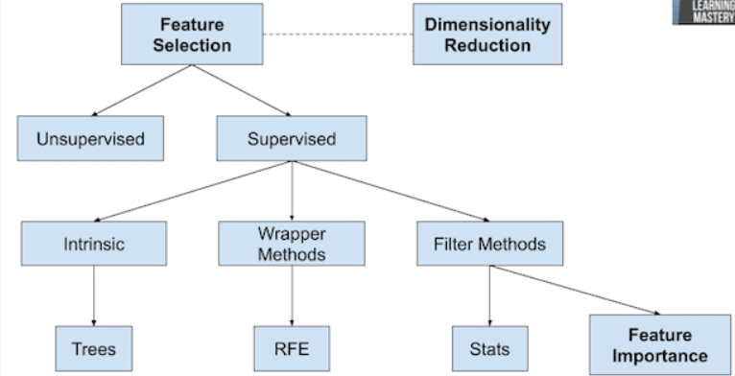
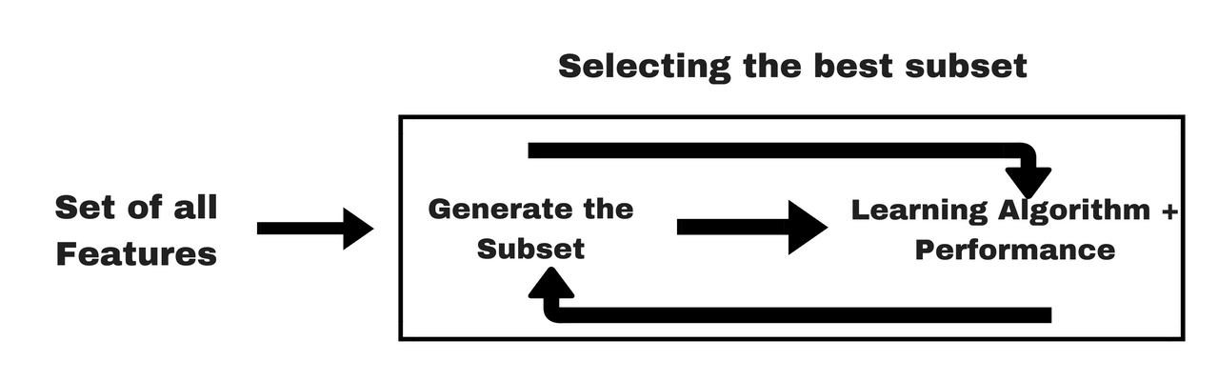
Feature Selection
Overview of feature Selection
Low Variance or Too many Unique Values:
If a feature is not varying across records (low variance) or has too many unique values
Wrapper Method – Recursive feature Elimination:
Eliminate the least useful feature recursively using a model
Feature Importance Selection Method – Select K Best:
Select the “k” best features based on the feature importance of a model
Embedded/Intrinsic Method – Lasso regression or Decision trees:
They learn best features while the model is being created itself. The L1 norm (Lasso regression) yields sparse solutions: many of the estimated coefficients become zero for unimportant variables during training.
Dimensionality Reduction
Lastly, dimensionality reduction methods such as PCA reduce (not exactly select) the feature space into fewer number of composite features/dimensions for modeling.
Wrapper Method for Feature Selection
Feature selection is done to make data dimensionality reasonable before modeling.
Notes:
Rule of Thumb: For many modeling techniques, we expect at least 30-40 data points per feature (so say 300-400 for 10 features and so on).
Caution: But don’t be forced to select/remove features unless
You are sure that feature is not useful or
The model is overfitting for the current dimensionality of data

Slide 19
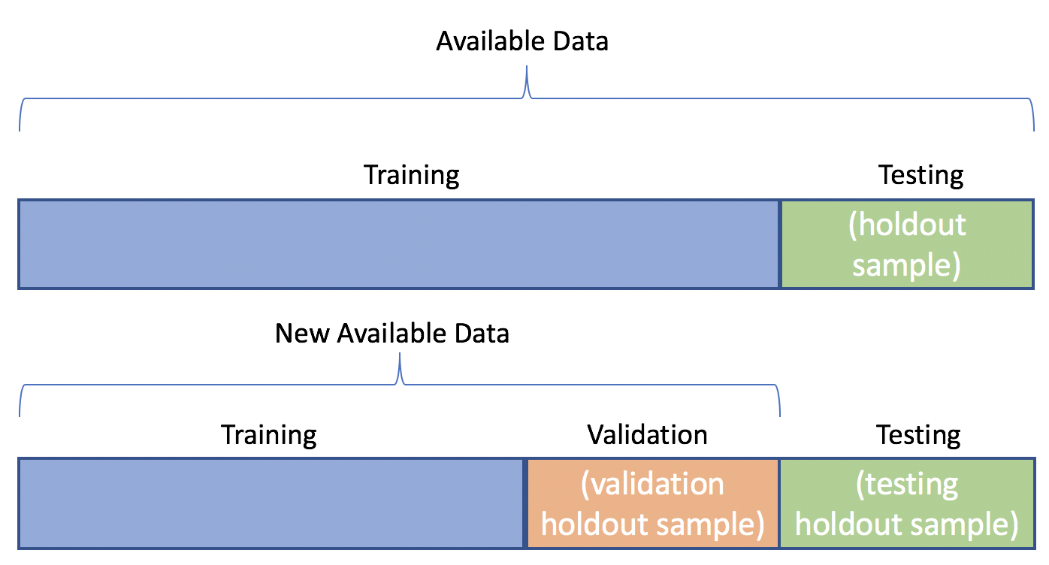
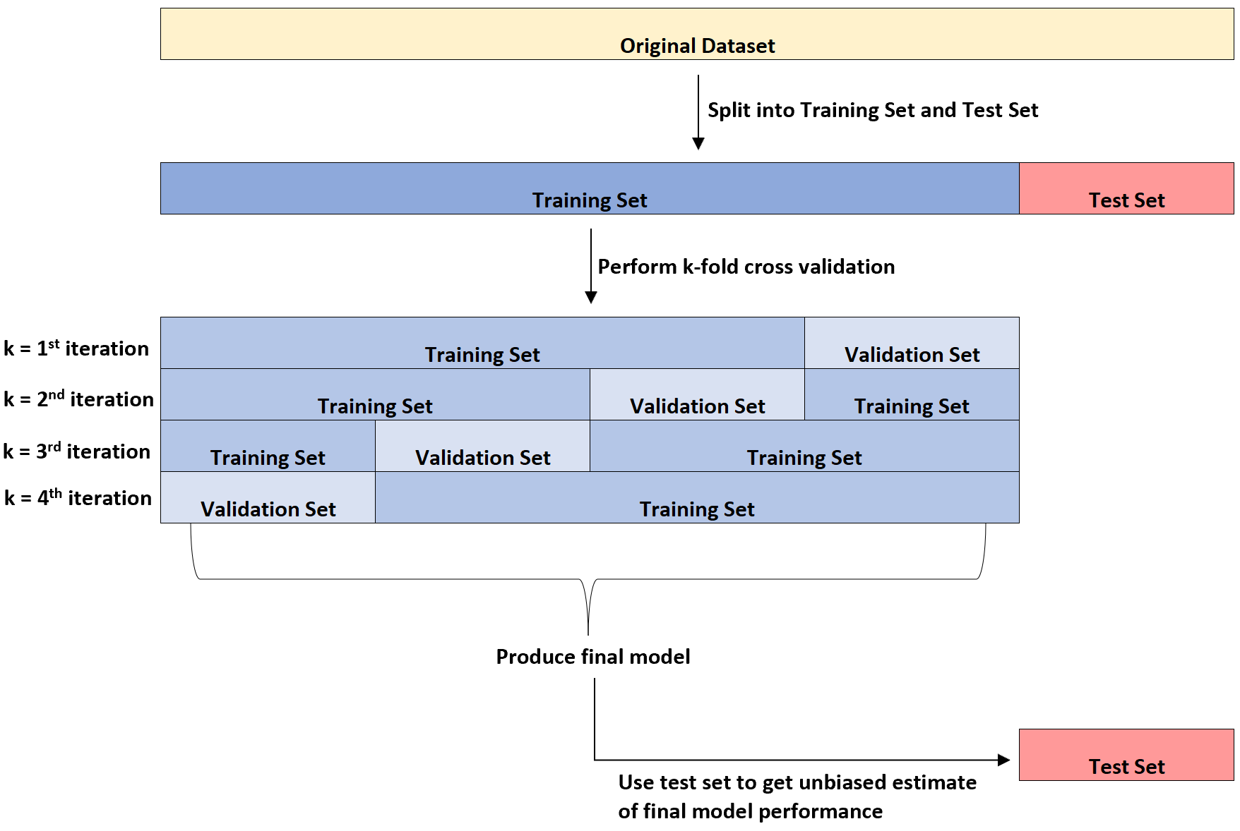
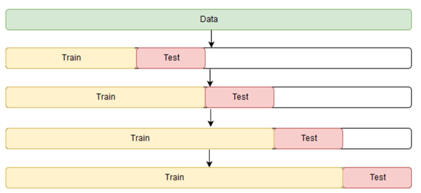
Data Split for Model Validation
Train Set - To fit the model or models
Validation Set - To tune the hyper-parameters and compare different models and
Test Set - To provide unbiased estimate of performance of final model
For training, can either have a single train and validation split or perform cross-validation (CV)
CV is more robust but also more time taking and compute intensive.
For time-series data, ensure that training
For datasets with class imbalance, use stratified k-fold CV (or specifiy stratify option in train_test_split sklearn method).
Train-Val-Test Split
K-Fold Cross Validation Time Series
K-Fold Cross Validation
Splitting data is essential to tune the model, compare different models and obtain final model’s performance estimate.

Slide 20
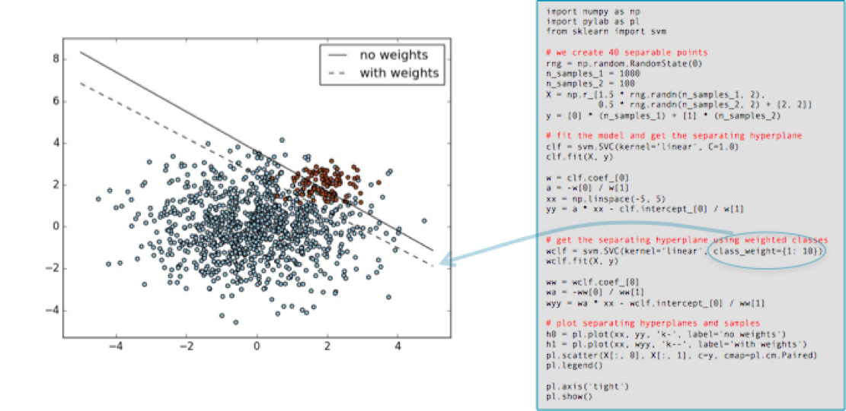
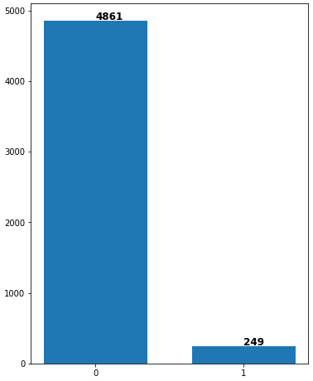
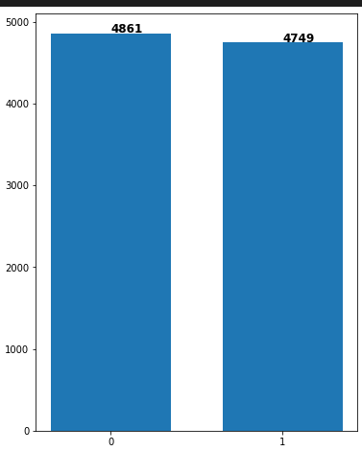
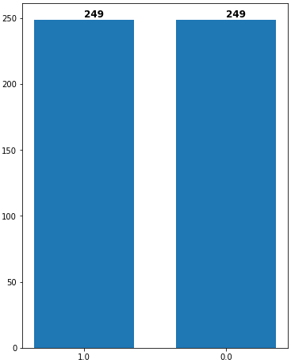
Class Imbalance
Model may be biased towards predicting the majority class to which most of the training data points belong to
Practical Examples: Defect Detection in Manufacturing, Fraud Detection in Financial Transactions etc.
Methods to address imbalance include Majority Under-sampling, Minority Over-sampling (like SMOTE), Unequal Class Weights
Higher class weights to minority class results in lower precision of majority class.
Majority under-sampling leads to loss of data while Minority Over-sampling leads to training set becoming different from test set or live data
Example of class imbalance
Up-sampling of minority class
Down-sampling of majority class
Every method to address class imbalance has its drawbacks and best approach varies case to case
Notes:
What are disadvantages of oversampling and undersampling?
(HINT: Test set will still see imbalance so train set no longer like test set; Undersampling decreases dataset size;
What is Problem of Class Weights?? NO FREE LUNCH!

Slide 21
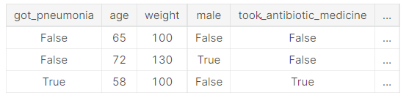
Data Leakage
What is Data Leakage & why is it important?
Information about the X or Y variables are made available erroneously
Artificially inflates model performance during development but does much worse in production
Need to watch out for data leakage in every step of the Data Science Workflow!
Two Types – Target Contamination and Train-Test Contamination
Target Contamination:
Predict Who is Sick with Pneumonia: Strong relationship between them, but “took_antibiotic_medicine” is changed after the value for “got_pneumonia” is determined. In reality, even when a person gets pneumonia they won’t get antibodies unless diagnosed for it.
Train-Test Contamination:
Information about Val or test Set is leaked during Data Preparation, so model’s Validation and Test Set performance is optimistic (not true)
Ensure there is no data leakage to get true estimate of model’s performance
Notes:
When information about the independent or dependent variable is made available during training which would not be available during prediction (when model is live) – So this artificially inflates performance on the training, validation and test set during development but model does much worse after deployment – You need to be careful in every stage in the pipeline to prevent this cardinal mistake!

Slide 22
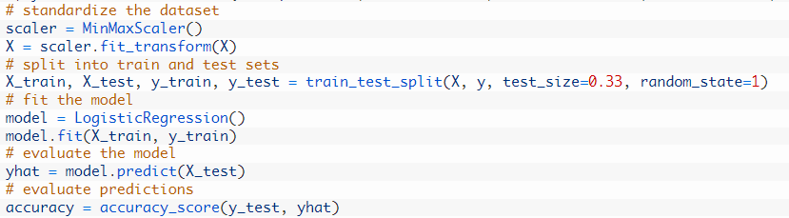
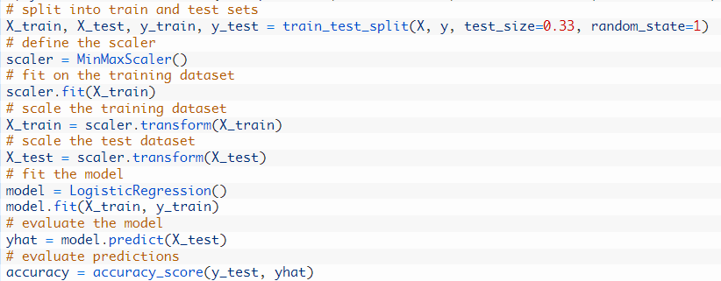
Data Leakage
Train-Test Contamination
Scaling: Min and max values of Test and Val Set (entire data) are considered for scaling training data – so already what range of values the model can expect is leaked! Similarly mean and std dev for standardization
Feature Selection:
If val set and test set values are included for RFE, Correlation Analysis, Select K Best methods, model already knows what values their features will have.
PCA: Cannot include Val & Test set data to derive the Principal Components
Feature Encoding: What type of categories can occur in Test Set must not be known
Train-Test Contamination Prevention – Follow Workflow IN THAT ORDER:
1. Split Data – Train, Test (Val also if doing hyper-parameter tuning)
2. Fit Data Preparation on Training Dataset (say MinMax or Standard Scaler class)
3. Apply as-is (NOT FIT) Data Preparation to Train, Val and Test Datasets.
✗
✓
Always perform train-test split BEFORE you do any sort of data preparation or feature engineering

Slide 23
Thank You

Slide 24
APPENDIX

Slide 25
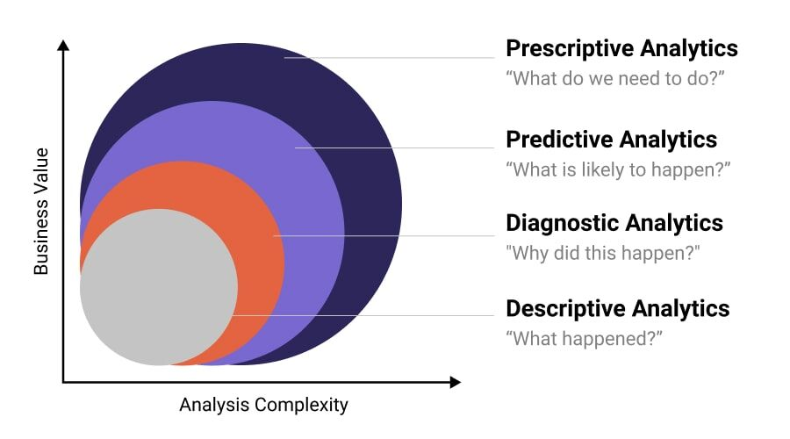
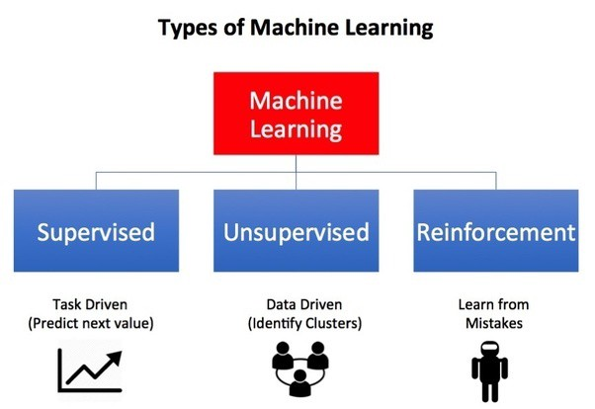
ML Basics
Types of Data Analysis
Types of Machine Learning Problems

Slide 26
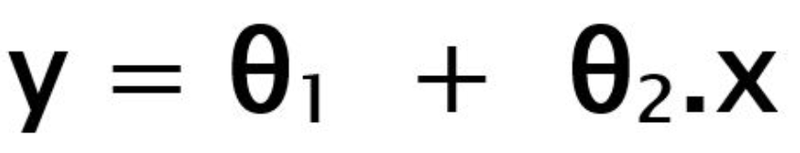
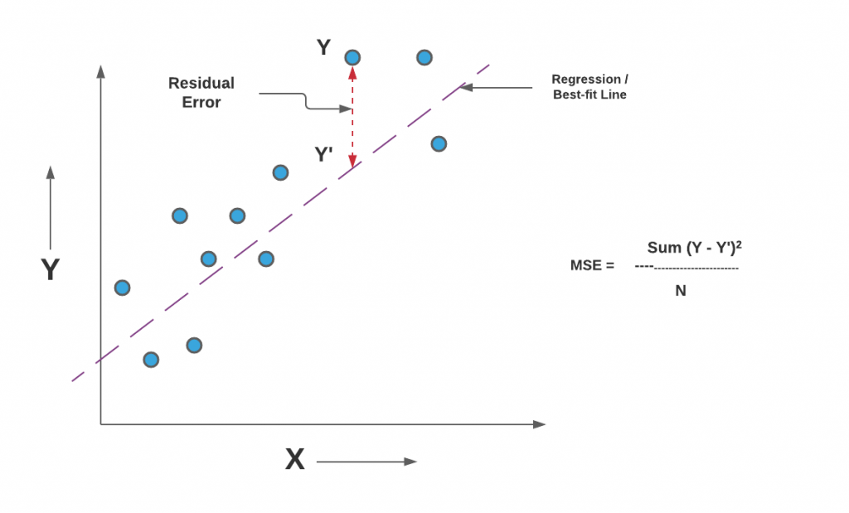
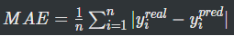



ML Basics
Linear Regression
Base model structure
Where x is independent(input) variable and y is dependent variable. ϴ₁₋₂ are model weights
Test train split
We split processed input data in test set and training set, usually in 20:80 ratio.
Training set is used to train model/optimize the cost function and test set is used to evaluate performance of trained model
Evaluation Metrics: MSE, MAE, RMSE, R2
Notes:
Why RMSE instead of MSE?
When MAE instead of MSE? MAE robust to outliers.
But if the problem demands special attention to handling corner cases or extreme values – MSE is better because of higher penalty.
Why R2? – Compare models; Scale invariant; R2 can be negative for a very bad (worse than simple mean) model.

Slide 27

ML Basics
Classification
Why not use Linear regression for Classification?
HINT: Look at “Y” to answer this WHY
Notes:
the green line is our hypothesis h(x)h(x). To make predictions we may say that for any given tumor size xx, if h(x)h(x) gets bigger than 0.50.5 we predict malignant tumor, otherwise we predict benign.

Slide 28


ML Basics
Classification
Why not use Linear regression for Classification?
Notes:
We cannot change the hypothesis each time a new sample arrives. Instead, we should learn it off the training set data, and then (using the hypothesis we've learned) make correct predictions for the data we haven't seen before.
WHY FUNDAMENTALLY? – BECAUSE THE Y VARIABLE IS NOT CONTINUOUS (1 IS NOT GREATER THAN 0)- (COMES BACK TO WHY LABEL ENCODING IS BAD). So technically, you can predict a continuous Y variable and then bin it (adapt Linear regression for Classification – but it won’t be good because that is not how the Y variable is meant to be treated)

Slide 29




ML Basics
Classification
Logistic Regression
Softmax/Sigmoid function:
These functions produce a probability score of a data point belonging to a particular class.
Classification using Sigmoid function
Confusion Matrix
For binary classification, the classes can be divided into positive or negative.
We interpret the output of hypothesis function as positive if it is ≥0.5, otherwise negative.
Notes:
Sigmoid maps to 0,1; It gives probability only – we can decide thresholds to convert to classification
Recall – identify mistakes in iphone assembly; tumor detection
Precision – recommender systems – giving good quality recos more important ok to miss some; Email spam detection – no important mail should be classified as spam

Slide 30


ML Basics
Other Classification Techniques
Decision Tree
K-nearest neighbors (KNN)
Notes:
QUESTION: Which of these 2 Algos do we need to do feature scaling for?
Which algorithm will take more time to train? What about to test/predict?

